Slide 1
Applications of Computer
Adaptive Testing in
Educational Assessment
By Oscar Li and Hajin Kim
Notes:
Hajin: Oh man that test was so tiring. Half of the questions were too easy, and the other half was way too hard!
Oscar: That sounds like a problem that computer adaptive testing can solve
Hajin: Really?
Oscar: Yes!​ That’s why we are here to talk about applications of computer adaptive testing in educational assessment. My name is oscar and i am with my partner hajin and this is our part 4 project

Slide 2
What is Computer Adaptive Testing?
Computer Adaptive Testing (CAT) is a form of testing that adapts to the user’s ability.
Uses item response theory (IRT) to measure user ability and select subsequent test items based on prior answers.
Aims to increase measurement precision while requiring the same or fewer test items compared to fixed length tests.
Becoming increasingly popular in large-scale learning assessments.
Notes:
1:10

Slide 3
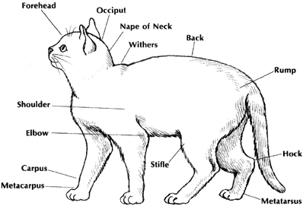
Traditional CAT Components
Item Response Model - models the probability of a correct answer based on person and item parameters
Item Pool - the complete set of test items
Entry Level - the level the test begins at
Item Selection - how each test item is selected
Scoring Method - estimating test taker ability based on item responses
Termination Criterion - when to stop the test
Notes:
3:15

Slide 4
Innovations in CAT
Question Adaptive Model (QAM)
Multistage Testing (MST)
Testlet D
Question Pool
Testlet B
Testlet E
Testlet A
Q1
Q2
Q3
Q4
Testlet C
Testlet F
O. Rotou, L. Patsula, M. Steffen, and S. Rizavi, “Comparison of multistage tests with computerized adaptive and
paper-and-pencil tests,” ETS Research Report Series, vol. 2007, no. 1, pp. i-27, 2007.
Notes:
4:00

Slide 5
Case Studies
Graduate Record Examinations (GRE): QAM (1993~2013), now MST (2014~)
National Assessment Program – Literacy and Numeracy (NAPLAN): MST (2017~)
Tradeoffs and why GRE & NAPLAN chose MST over QAM:
Full evaluation of each testlet is possible before delivery
Students can review responses
Less cost in ensuring that each test set measures students equally well
Greater security: limits can be imposed on testlet reuse and test item overlap between testlets
Notes:
4:49

Slide 6

cat
4 more slides to go!

Slide 7

CAT Software Frameworks
catR: question adaptive model
R framework that is actively maintained and very comprehensive.
Used extensively in simulations, research and open source (eg concerto)
mstR: multistage adaptive test
R framework with the most solid ground in Item Response Theory out of all the MST frameworks.
Inspired by catR, so easy to learn
Notes:
Implemnetation of CAT sounds simple at a first glance. but implementation from scratch is quite infeasible. that’s because the models behind CAT are very complex.
These are the frameworks that provide common CAT modules, so that we don’t have to care about implementing CAT models correctly.
we have explored many frameworks, but these two frameworks had the biggest share in research and open source community.
for implementing question adaptive model, we have catR. catR is a very widely used R framework both in research and open source community. It backs up the largest open source CAT platform called concerto. It pretty much provides all the models and variations of those models that you might need to implement CAT. there are other frameworks for implementing question adaptive model, but there are no frameworks as large, actively maintained and comprehensive as catR framework.
in the area of multistage adaptive test, mstR is the only framework that is built as robust and comprehensive as catR. It is the only R framework that provides proper implementation of common cat routines. It is also easy to learn as it was inspired by catR.
In summary, we decided to use these two frameworks, one for implementing question adaptive model CAT, and another for multistage adaptive test.
-----------
hajin:
One of our main goal is to implement a working CAT prototype.
For implemneting question adaptive model CAT, we found two frameworks from research.
OSCATS provides….. downsides...makes it less appealing to use
catR….
For Mulstistage Adaptive Testing, there is only one framework that is able to provide very solid implementations of MST.
in fact it is the only CRAN package….
Out of these frameworks, catR and mstR had the most documentations and researches, which meant that we will most likely focus on exploring those two packages (one for MST and one for QAM)
The gap in the resaerch is that there are not many empirical researches around MST.
1. …=> it would contribute to the research if we conduct an emirical research around MST implementation
2. => it would be interesting and significant to observe if any results from other demographics are consistent with our findings with secondary school students
3. => our implemetation will be valuable to the research community

Slide 8
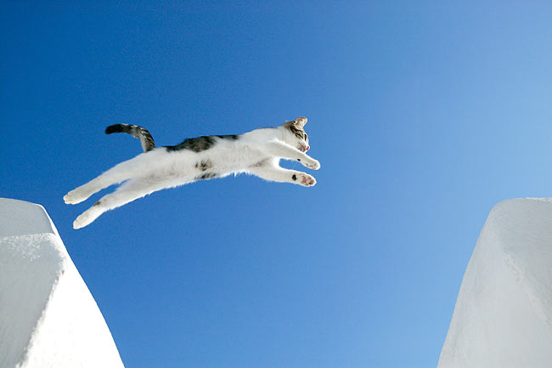
Gap in research
Lack of open sourced CAT implementations in general (especially MST!)
Only a few open source from research: campsych/concerto-platform and oopl/AdaptiveTesting.
Lack of studies targeting secondary school demographic
GRE - university graduate students, NAPLAN - primary students
Lack of empirical studies comparing MST and QAM
GRE compared MST and QAM empirically.
Notes:
1/2: replicate studies and see if results are consistent
1: also encourage adoption of CAT at small scales
3: given current trend, would be significant

Slide 9
Research Intent
Create a CAT platform prototype
Based on multiple models presented in CAT literature
Leverage CAT frameworks and modern web stack
Compare MST and QAM
Through an experiment on secondary school demographics
Research output: open source CAT implementation, empirical study results, software architecture
Notes:
so naturally...
and by doing so....

Slide 10


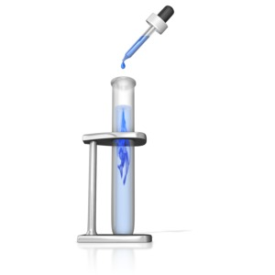
Project Timeline
May-June
Design the empirical study
Ethics application
Start implementing CAT
July-August
Pilot test & iterate on study design
Continue implementing CAT
Document findings and results
September-October
Test on high school students
Document findings & results
Conduct seminar & finish report
Notes:
10:20

